Slide 1



19CSE301 COMPUTER NETWORKS
3-0-0 4

Slide 2
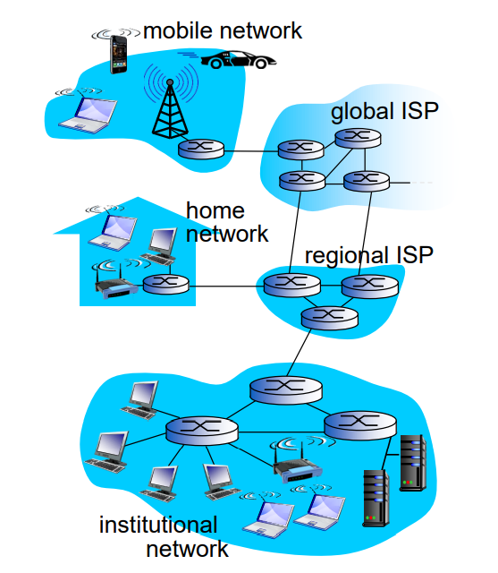

Slide 3
The Network Core
Circuit Switching
Packet Switching

Slide 4
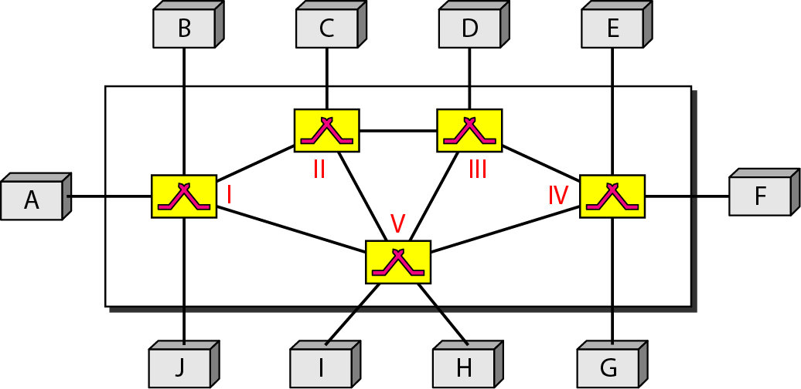
Switching
In large networks, there can be multiple paths from sender to receiver. The switching technique will decide the best
route for data transmission.
Switching technique is used to connect the systems for making one-to-one communication.

Slide 5
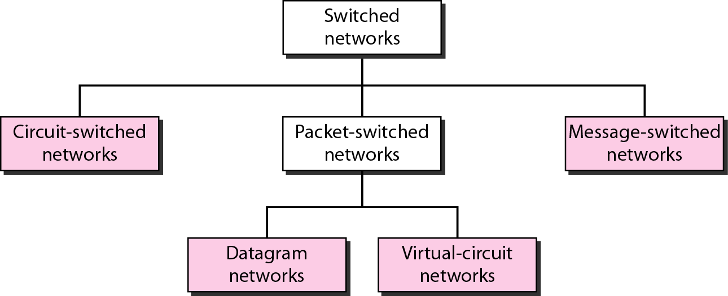
Taxonomy of switched networks

Slide 6
Circuit Switching

Slide 7



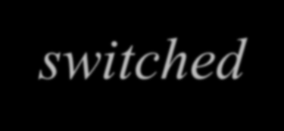
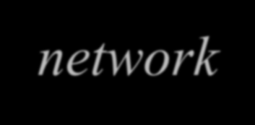


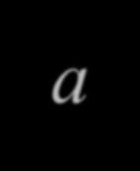



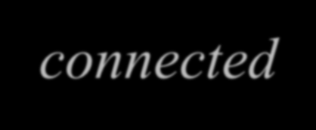

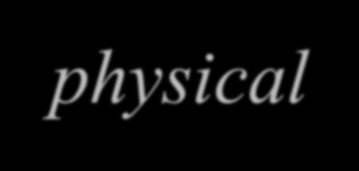


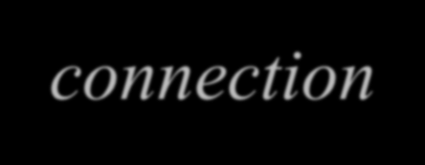

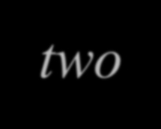
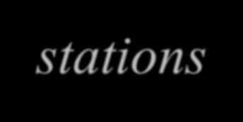

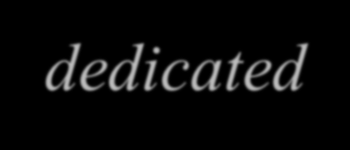



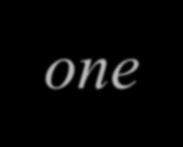



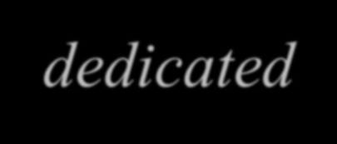





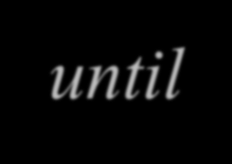

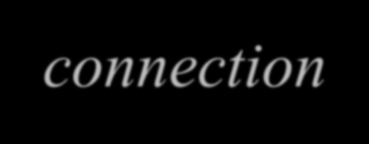




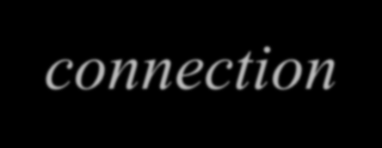


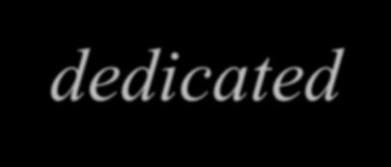
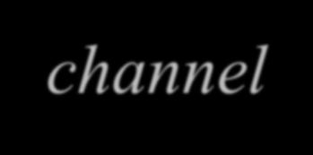


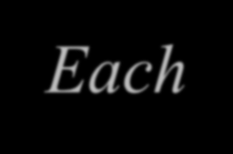


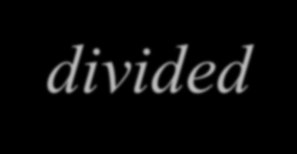
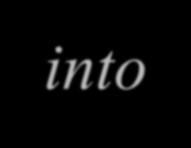
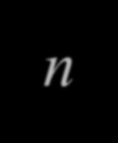





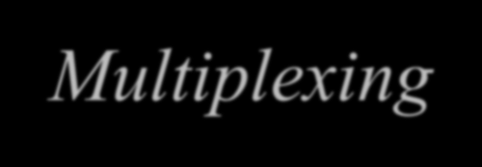
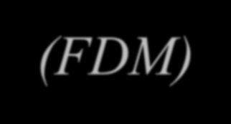


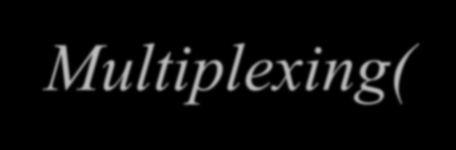


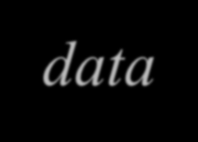






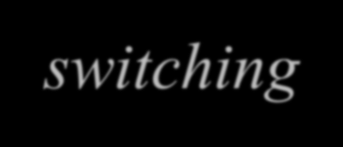











Circuit Switching
A circuit-switched network consists of a set of switches connected by physical links.
A connection between two stations is a dedicated path made of one or more links. The dedicated path will remain to exist until the connection is terminated.
However, each connection uses only one dedicated channel on each link.
Each link is normally divided into n channels by using Frequency Division Multiplexing (FDM) or Time Division Multiplexing( TDM).
Fixed data can be transferred at a time in circuit switching technology.
Circuit switching is used in public telephone network. It is used for voice transmission.

Slide 8
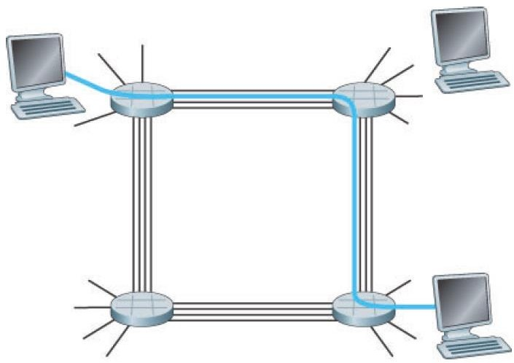
A circuit Switched Network
In this network, the four circuit switches are interconnected by four links.
Each of these links has four circuits, so that each link can support four simultaneous connections.
The dedicated end-to-end connection in the fig uses the second circuit in the first link and the fourth circuit in the second link
The connection gets one fourth of the link’s total transmission capacity for the duration of the connection.
For example, if each link between adjacent switches has a transmission rate of 1 Mbps then each end-to-end circuit-switch connection gets 250 kbps of dedicated transmission rate.
A simple circuit-switched network consisting of four switches and four links

Slide 9
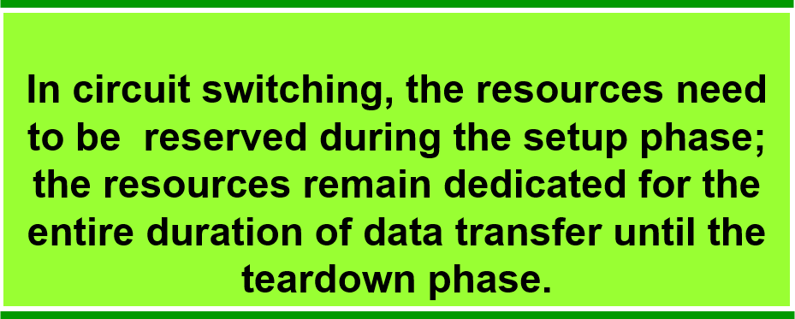
Circuit Switching
When the network establishes the circuit, it also reserves a constant transmission rate in the network’s links (representing a fraction of each link’s transmission capacity) for the duration of the connection. Since a given transmission rate has been reserved for this sender-to receiver connection, the sender can transfer the data to the receiver at the guaranteed constant rate

Slide 10
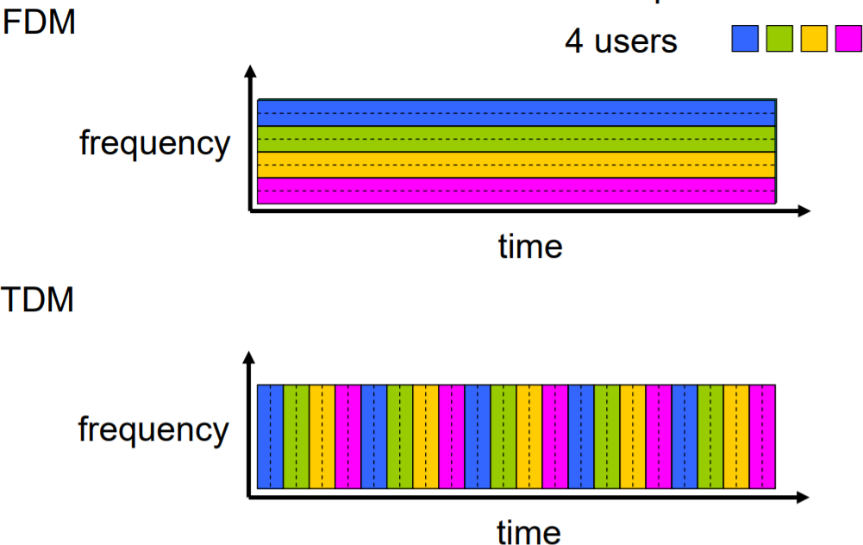
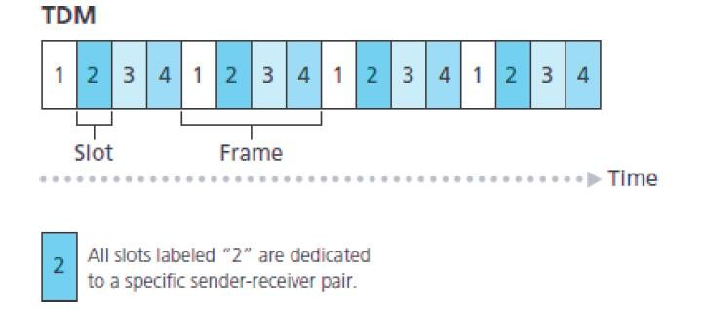
Circuit Switching : FDM & TDM
With FDM, the frequency spectrum of a link is divided up among the connections established across the link. Specifically, the link dedicates a frequency band to each connection for the duration of the connection.
-Telephone networks, -frequency band – has a width of 4KHz
FM radio stations also use FDM to share the frequency spectrum between 88 MHz and 108 MHz
Frequency Division Multiplexing ( FDM)
For a TDM link, time is divided into frames of fixed duration, and each frame is divided into a fixed number of time slots.
When the network establishes a connection across a link, the network dedicates one time slot in every frame to this connection
Time Division Multiplexing ( TDM)

Slide 11
Packet Switching

Slide 12
Packet Switching - Introduction
Packet switching is a method of transferring the data to a network in form of packets when end systems exchange messages with each other
In order to transfer the file fast and efficient manner over the network and minimize the transmission latency, the data such as an e-mail message,a JPEG image, or an MP3 audio file is broken into small pieces of variable length (smaller chunks of data), called Packet.
At the destination, all these small-parts (packets) has to be reassembled,
belonging to the same file
Size of the packet is decided by the network and governing protocol
Packets are transmitted over each communication link at a rate equal to the full transmission rate of the link. So, if a source end system or a packet switch is sending a packet of L bits over a link with transmission rate R bits/sec, then the time to transmit the packet is L/R seconds.

Slide 13
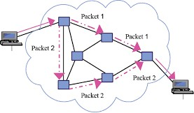
Packet Switching - Introduction
Packet-switching
Hosts break application-layer messages into packets
Forward packets from one router to the next, across links on path from source to destination
Used for transferring messages across a network
Does not require a pre-setup or reservation of dedicated network resource

Slide 14

Switching and Forwarding
Two types of packet switches - routers and link layer switches)
Uses store-and-forward mechanism for transmission
What is a router?
A networking device that forwards data packets between computer networks. Router takes a packet arriving on one of its attached communication links and forwards that packet onto another one of its attached communication links
What is a Switch?
A mechanism that allows us to interconnect links to form a large
network,
a device that connects other devices together
A multi-input, multi-output device
Multiple data cables are plugged into a switch to enable
communication between different networked devices.

Slide 15
Sending packets over a Link with Bandwidth (B)
Bandwidth
Width of the frequency band
Number of bits per second (bps) that can be transmitted over a communication link
Consider a Link with bandwidth 1 Mbps
1 Mbps: 1 x 10⁶ bits/second
How long it takes to send 1 bit ? 1 x 10⁻⁶ seconds
Each bit occupies 1 micro second space.

Slide 16
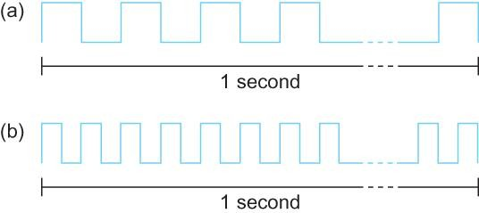
Bandwidth
Copyright © 2010, Elsevier Inc. All rights Reserved
Bits transmitted at a particular bandwidth can be regarded as having some width:
bits transmitted at 1Mbps (each bit 1 μs wide);
bits transmitted at 2Mbps (each bit 0.5 μs wide).

Slide 17










Packet-Switching: Delay calculation (D)
3 2 1
R bps
destination
R bps
source
Store and forward - entire packet must arrive at router before it can be transmitted on next link
L: length of the packet= 7.5 Mbits (1Mb= 10⁶ bits)
R: capacity of the link/bandwidth = 1.5Mbps
takes L/R seconds to transmit (push out) L-bit packet into link at R
bps
one-hop transmission delay = L/R = 5 sec
1 bit -→ 1/R sec
L bits------L/R sec

Slide 18
Delay x Bandwidth (D x B)
Delay Bandwidth product
if the sender wants to keep the pipe full how much data the sender must transmit before the first bit arrives at the receiver
If the sender does not fill the link with enough data before the next signal, the network link is not fully utilized.
Delay of 40 ms and bandwidth of 15 Mbps
⇒40 x 10⁻³ seconds x 15 x 10⁶ bits/second
⇒0.6 x 10⁶ bits = 600 KB data.
Bandwidth delay product is a measurement of how many bits can fill up a network link.

Slide 19
Delay x Bandwidth
Link between a pair of processes can be thought of a hollow pipe
Latency (delay) = length of the pipe
bandwidth = the width of the pipe
Network as a pipe
Bandwidth
Delay

Slide 20
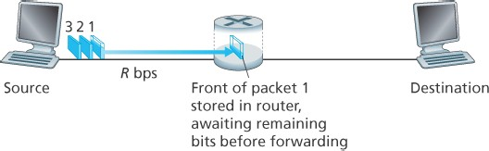
Store-and-forward transmission
Store-and-forward transmission means that the packet switch must receive the entire packet before it can begin to transmit the first bit of the packet onto the outbound link
In this example, the source has three packets, each consisting of L bits, to send to the destination.
At time L/R, the router begins to forward the first packet. But also at time L/R the source will begin to send the second packet, since it has just finished sending the entire first packet. Thus, at time 2L/R, the destination has received the first packet and the router has received the second packet. Similarly, at time 3L/R, the destination has received the first two packets and the router has received the third packet. Finally, at time 4L/R the destination has received all three packets
Advantage : This technique is very beneficial because packets may get discarded at any hop due to some reason. If there is congestion at some path, packets are allowed to choose different path possible over existing network.

Slide 21
Forwarding Tables and Routing Protocols
Router takes a packet arriving on one of its attached communication links and forwards that packet onto another one of its attached communication links. But how does the router determine which link it should forward the packet onto?
2) When a packet arrives at a router in the network, the router examines a portion of the packet’s destination address and forwards the packet to an adjacent router. More specifically, each router has a forwarding table that maps destination addresses to that router’s outbound links
1) Every end system has an address called an IP address. When a source end system wants to send a packet to a destination end system, the source includes the destination’s IP address in the packet’s header
3) When a packet arrives at a router, the router examines the address and searches its forwarding table, using this destination address, to find the appropriate outbound link. The router then directs the packet to this outbound link

Slide 22
Packet Switching vs Circuit Switching
Disadvantage of Packet Switching
Packet Switching don’t give packets in order, whereas Circuit Switching provides ordered delivery of packets because all the packets follow the same path.
Since the packets are unordered, we need to provide sequence numbers to each packet.
Complexity is more at each node because of the
facility to follow multiple path.
Transmission delay is more because of rerouting.
Packet Switching is beneficial only for small messages, but for bursty data (large messages) Circuit Switching is better.
Advantage of Packet Switching over Circuit Switching :
More efficient in terms of bandwidth, since the concept of reserving circuit is not there.
More reliable as destination can detect the missing packet.
More fault tolerant because packets may follow different path in
case any link is down, Unlike Circuit Switching.
Cost effective and comparatively cheaper to implement.

Slide 23
Packet Switching
Virtual Circuit Network (Connection-
oriented Packet Switching )
Datagram Network (Connectionless Packet Switching)
The Internet which we use is based on Datagram network.
ATM (Asynchronous Transfer Mode) and frame relay – are virtual circuit networks

Slide 24
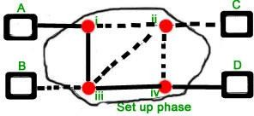
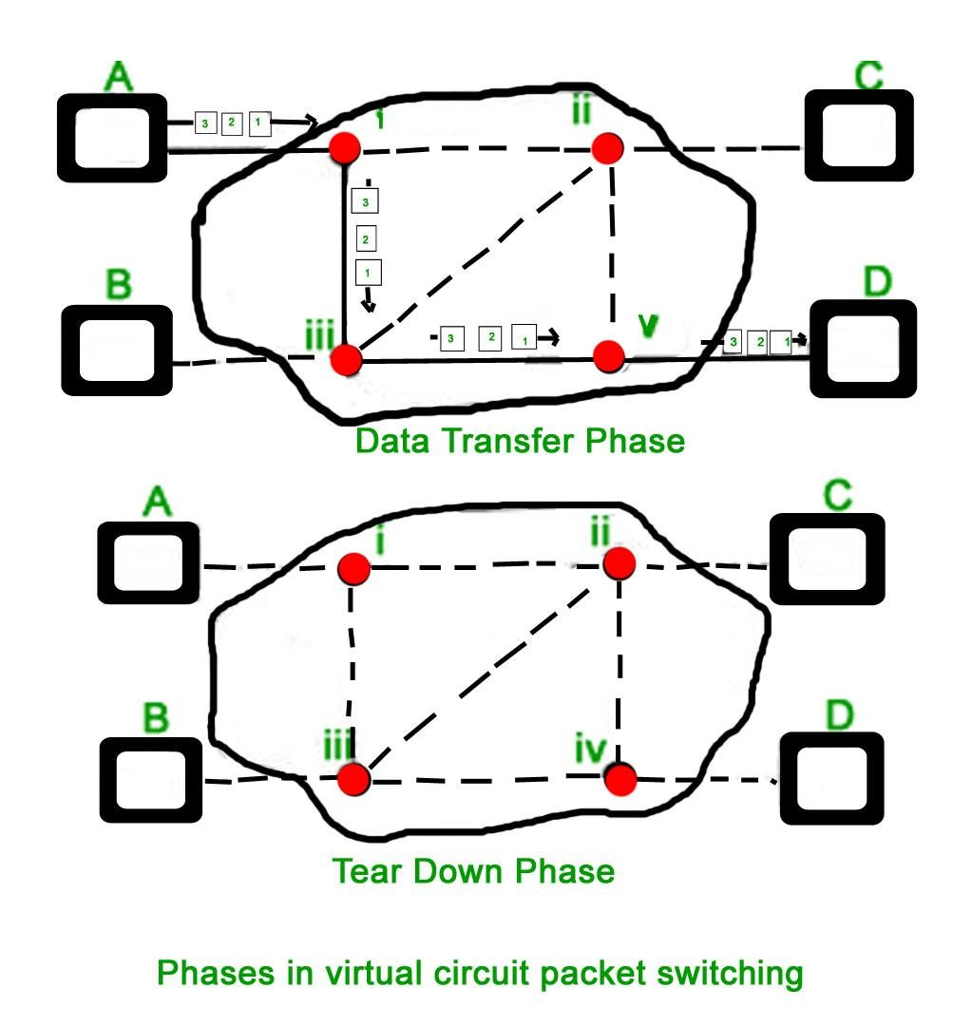
Connection-oriented Packet Switching (Virtual Circuit Networks)
Before starting the transmission, it establishes a logical path or
virtual connection using signalling protocol, between sender
and receiver and all packets belongs to this flow will follow this
predefined route.
Virtual Circuit ID is provided by switches/routers to uniquely
identify this virtual connection. Data is divided into small units
and all these small units are appended with help of sequence
number. Overall, three phases takes place here- Setup, data
transfer and tear down phase.
All address information is only transferred during setup phase.
Once the route to destination is discovered, entry is added to
switching table of each intermediate node. During data transfer,
packet header (local header) may contain information such as
length, timestamp, sequence number etc.
•
Connection-oriented switching is very useful in switched WAN.
Some popular protocols which use Virtual Circuit Switching
approach are X.25, Frame-Relay, ATM and MPLS(Multi-Protocol
Label Switching).

Slide 25
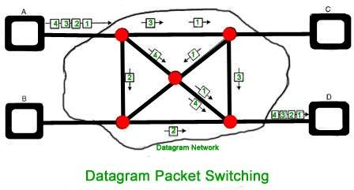
Connectionless Packet Switching (Datagram)
Unlike Connection-oriented packet switching, In Connectionless Packet Switching each packet contains all necessary addressing information such as source address, destination address and port numbers etc.
In Datagram Packet Switching, each packet is treated independently. Packets belonging to one flow may take different routes because routing decisions are made dynamically, so the packets arrived at destination might be out of order. It has no connection setup and teardown phase, like Virtual Circuits.
Packet delivery is not guaranteed in connectionless packet switching, so the reliable delivery must be provided by end systems using additional protocols.
A---R1---R2---B A is the sender (start) R1, R2 are two routers that store and forward data B is receiver(destination)
To send a packet from A to B there are delays since this is a Store and Forward network.

Slide 26



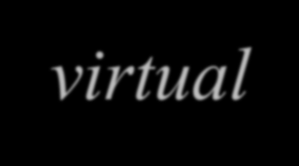




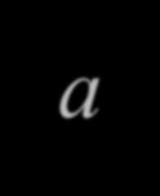





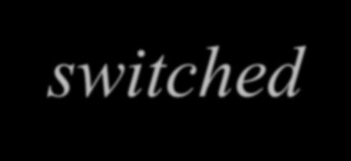













VIRTUAL-CIRCUIT NETWORKS
A virtual-circuit network is a cross between a circuit- switched network and a datagram network. It has some characteristics of both.
8.26

Slide 27
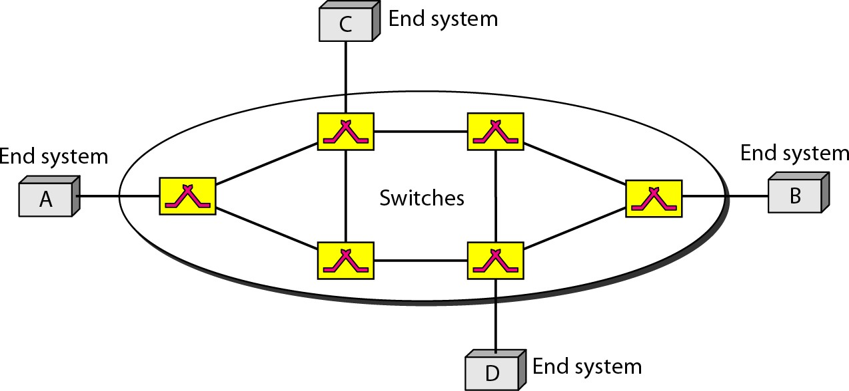
Figure 8.10 Virtual-circuit network
8.27

Slide 28
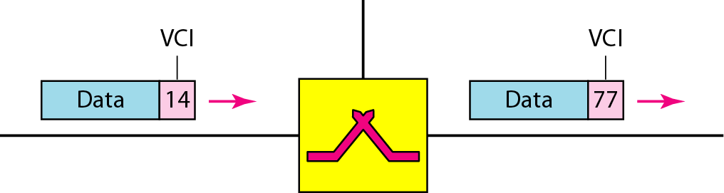
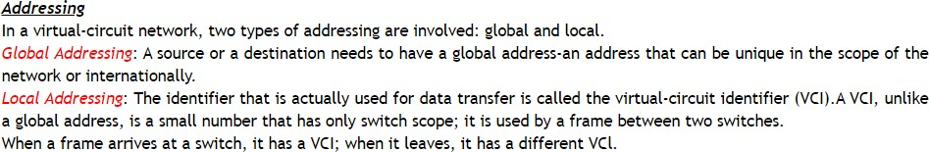
Figure 8.11 Virtual-circuit identifier
8.28

Slide 29
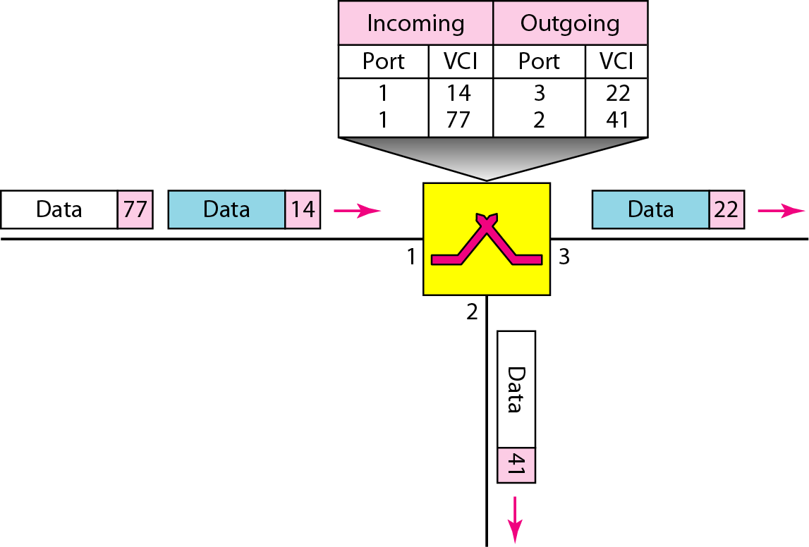
Figure 8.12 Switch and tables in a virtual-circuit network
8.29

Slide 30
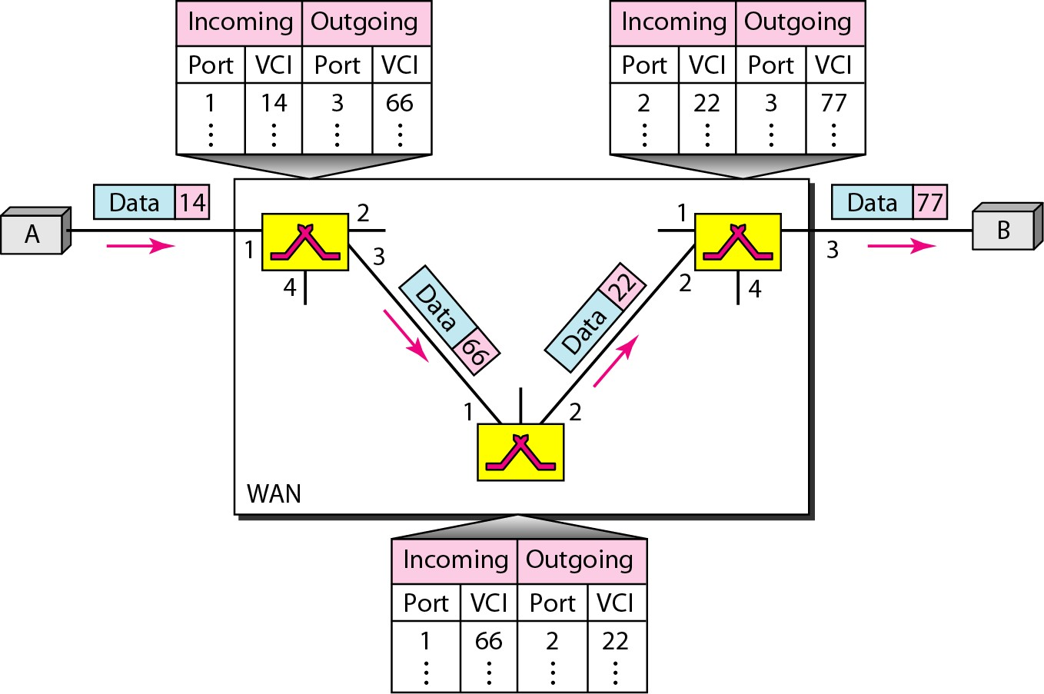
Figure 8.13 Source-to-destination data transfer in a virtual-circuit network
8.30

Slide 31

DATAGRAM NETWORKS
Datagram packet-switching is a packet
switching technology by which each packet, now called a datagram, is treated as a separate entity.
Each packet is routed independently through
the network. ... As a result, the packets may arrive at the destination out of order.
8.31

Slide 32


Slide 33
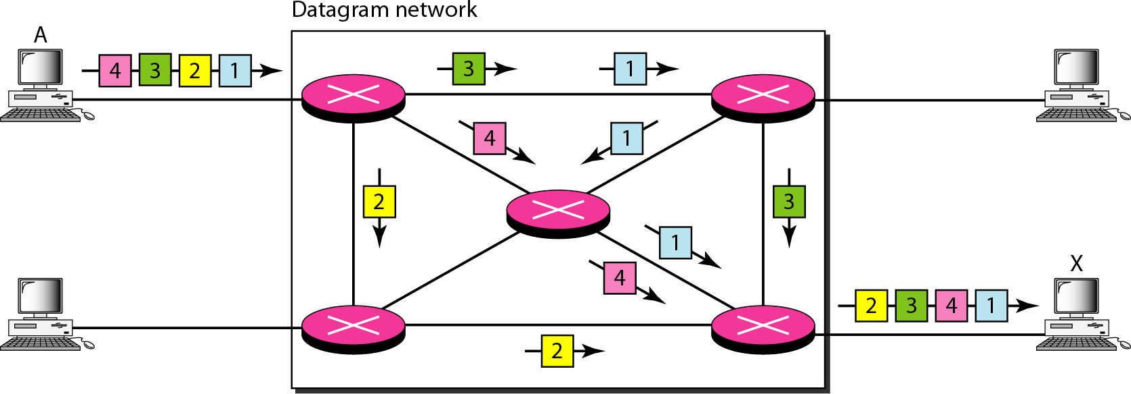
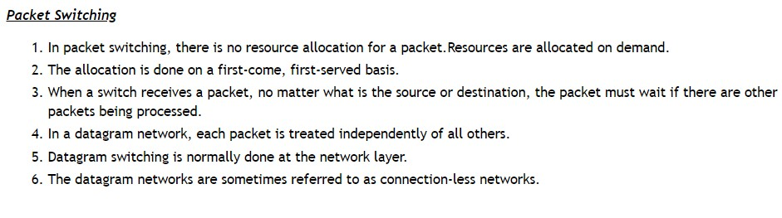
Figure 8.7 A datagram network with four switches (routers)
8.33

Slide 34
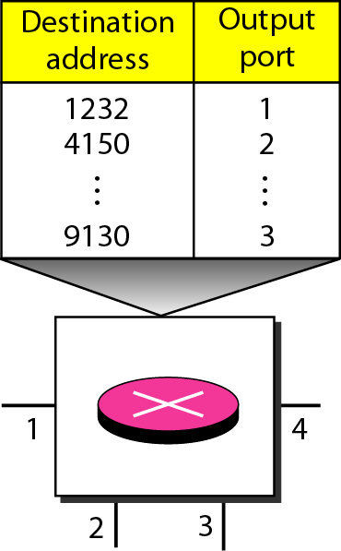
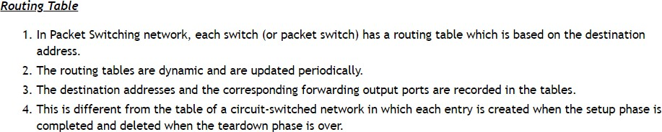
Figure 8.8 Routing table in a datagram network
8.34

Slide 35




Note
A switch in a datagram network uses a routing table that is based on the destination address.
8.35

Slide 36
Note
The destination address in the header of a packet in a datagram network
remains the same during the entire journey of the packet.
8.36

Slide 37
Note
Switching in the Internet is done by using the datagram approach
of packet switching at the network layer.
8.37

Slide 38
Difference -Virtual Circuits/Datagram Networks
Virtual Circuits | Datagram Networks
Virtual circuits are connection-oriented, which means that there is a reservation of resources like buffers, bandwidth, etc. for the time during which the newly setup VC is going to be used by a data transfer session. | It is connectionless service. There is no need for reservation of resources as there is no dedicated path for a connection session.
A virtual circuit network uses a fixed path for a particular session, after which it breaks the connection and another path has to be set up for the next the next session. | A Datagram based network is a true packet switched network. There is no fixed path for transmitting data.
All the packets follow the same path and hence a global header is required only for the first packet of connection and other packets will not require it. | Every packet is free to choose any path, and hence all the packets must be associated with a header containing information about the source and the upper layer data.
Packets reach in order to the destination as data follows the same path. | Data packets reach the destination in random order, which means they need not reach in the order in which they were sent out.
Virtual Circuits are highly reliable. | Datagram networks are not as reliable as Virtual Circuits.
Implementation of virtual circuits is costly as each time a new connection has to be set up with reservation of resources and extra information handling at routers. | But it is always easy and cost-efficient to implement datagram networks as there is no need of reserving resources and making a dedicated path each time an application has to communicate

Slide 39
Overview of Delay in Packet-Switched Networks

Slide 40

Delay in Packet-Switched Networks
As a packet travels from one node (host or router) to the subsequent node (host or router) along this path, the
packet suffers from several types of delays at each node along the path.
The performance of many Internet applications—such as search, Web browsing, e-mail, maps, instant messaging, and voice-over-IP—are greatly affected by network delays

Slide 41


Delays in Packet switching
Transmission Delay :
Time taken to put a packet onto link. In other words, it is simply time required to put data bits on the wire/communication medium. It depends on length of packet
1.Transmission Delay 2.Propagation Delay 3.Queuing Delay 4.Processing Delay
and bandwidth of network.
Transmission Delay = Data size / bandwidth = (L/R) second
Propagation delay :
Time taken by the first bit to travel from sender to receiver end of the link. In other words, it is simply the time required for bits to reach the destination from the start point. Factors on which Propagation delay depends are Distance and propagation speed.
Propagation delay = distance/transmission speed = d/s

Slide 42

Queuing Delays and Packet Loss
If an arriving packet needs to be
Each packet switch has multiple links attached to it. For each
transmitted onto a link but finds the link busy with the
attached link, the packet switch has an output buffer (also called transmission of another packet, the arriving packet
an output queue), which stores packets that the router is about to send into that link
must wait in the output buffer. Thus, in addition to the store-and-forward delays, packets suffer output buffer queuing delays.

Slide 43


Queuing Delay
Waiting time for the packets in front to be transmitted
Average Queuing delay = (N-1)L/(2*R) where N = no. of packets
L=size of packet R=bandwidth
Queuing Delay :
Dependence of average queuing delay on
traffic intensity.
Queuing delay is the time a job waits in a queue until
it can be executed. It depends on congestion.
Sum of the delays encountered by a
If La/R > 1, then the average rate at which
bits arrive at the queue exceeds the rate at which the bits can•
be transmitted from the queue ,then queue will tend to increase packet between the time of insertion into the
without bound and the queueing delay will approach
infinity! •
network and the time of delivery to the address. The delay is dependent on the arrival rate of the incoming packets, the transmission capacity of the
outgoing link, and the nature of the network’s​ traffic.
Design your system so that the traffic intensity is no greater than 1.

Slide 44
Packet Loss
We have assumed that the queue is capable of holding an infinite number of packets. In reality a queue preceding a
link has finite capacity,
The queuing capacity greatly depends on the router design and cost. Because the queue capacity is finite, packet delays do not really approach infinity as the traffic intensity approaches 1.
Instead, a packet can arrive to find a full queue. With no place to store such a packet, a router will drop that packet;
that is, the packet will be lost.
A packet loss will look like a packet having been transmitted into the network core but never emerging from the network at the destination.
The fraction of lost packets increases as the traffic intensity increases.
Performance at a node is often measured not only in terms of delay, but also in terms of the probability of packet loss.
A lost packet may be retransmitted on an end-to-end basis in order to ensure that all data are eventually transferred from source to destination ( will learn in subsequent chapters)

Slide 45
Delays in Packet switching
Processing Delay :
Processing delay is the time it takes routers to process the packet header. Processing of packets helps in detecting bit-level errors that occur during transmission of a packet to the destination. Processing delays in high-speed routers are typically on the order of microseconds or less. In simple words, it is just the time taken to process packets.
Total time or End-to-End delay= Transmission delay + Propagation delay+ Queuing delay + Processing delay
For M hops –
End –to End Packet latency or delay = M* Link Delay + Queuing Delay
End to End delay or OneWay Delay(OWD) refers to the time taken for a packet to be transmitted across a network from source to destination

Slide 46
Delays in Packet switching
Total time or End-to-End delay= Transmission delay + Propagation delay+ Queuing
delay + Processing delay
For M hops –
End –to End Packet latency or delay = M*Link Delay + Queuing delay
Link Delay=Transmission delay + Propagation delay+ Processing delay
For M hops and N packets –
Total delay = M*(Transmission delay + propagation delay)+ (M-1)*(Processing delay +
Queuing delay) + (N-1)*(Transmission delay)
Delay can also be calculated as : Delay for 1st packet to reach + delay for (N-1) packets
Delay for 1st packet = M*(Propagation delay + Transmission delay) + (M-1)*(Processing delay + Queuing
delay)
Delay for N-1 remaining packets = (N-1)*(Transmission delay)
End to End delay or OneWay Delay(OWD) refers to the time taken for a packet to be transmitted across a network from source to destination

Slide 47

Using Traceroute to discover network paths and measure network
Traceroute- delay
Traceroute is a simple program that can run in any Internet host. When the user specifies a destination hostname, the
program in the source host sends multiple, special packets toward that destination.
As these packets work their way toward the destination, they pass through a series of routers. When a router receives one of these special packets, it sends back to the source a short message that contains the name and address of the router. the last three columns are the round-trip delays for three experiments
Suppose there are N-1 routers between the source and the destination. Then the source will send N special packets into the network. When the nth router receives the nth packet marked n, the router does not forward the packet toward its destination, but instead sends a message back to the source. When the destination host receives the Nth packet, it too returns a message back to the source. The source records the time that elapses between when it sends a packet and when it receives the corresponding return message

Slide 48

Throughput in Computer Networks
In addition to delay and packet loss, another critical performance measure in computer networks is end to- end
throughput
Consider transferring a large file from Host A to Host B across a computer network. If the file consists of F bits and the transfer takes T seconds for Host B to receive all F bits, then the average throughput of the file transfer is F/T bits/sec
Rs and Rc rate of each link,
Suppose only bits being sent in the entire network below are those from the server to the client, what is the server-to-client throughput?
If Rs<Rc
then the bits pumped by the server will “flow” right through the
router and arrive at the client at a
rate of Rs bps, giving a throughput of Rs bps
If Rc<Rs then the router will not be able to forward
bits as quickly as it receives them.
In this case, bits will only leave the router at rate Rc , giving an end-to-end throughput of Rc
Hence for this simple two-link network, the throughput is min{Rs , Rc }, that is, it is the transmission rate of the bottleneck link

Slide 49


Throughput in Computer Networks
Shows a network with N links between the server and the client, with the transmission rates of the N links being
{R1,R2,….Rn}
The throughput for a file transfer from server to client is min{R1,R2….Rn}
The server is connected to the network with an access link of rate Rs and the client is connected to the network with an access link of rate Rc . Now suppose that all the links in the
core of the communication network have very high transmission rates, much higher than Rs and Rc .
Throughput = min(Rs,Rc)
The constraining factor for throughput in today’s Internet is typically the access network.

Slide 50

Throughput in Computer Networks
there are 10 servers and 10 clients connected to the core of the computer network. In this example, there are 10 simultaneous downloads taking place, involving 10 client-server pairs
Suppose that these 10 downloads are the only traffic in the network:
There is a link in the core that is traversed by all 10 downloads. Denote R for the transmission rate of this link R.
Case 1: Suppose that all server access links have the same rate Rs , all client access links have the same rate Rc , and the transmission rates of all the links in the core—except the one common link of rate R—are much larger (100 times)than Rs and Rc Then throughput = min{Rs,Rc}
Case 2:what if the rate of the common link is of the same order as Rs and Rc ? -common link divides its transmission rate equally among the 10 downloads
Rs=2Mbps,Rc=1 Mbps, R=5Mbps, Throughput = (
5000
kbps)= 500kbps
10

Slide 51
Problems

Slide 52

Problem I

Slide 53

Problem I- answer

Slide 54

Problem II

Slide 55
Delays in Packet switching
Processing Delay :
Processing delay is the time it takes routers to process the packet header. Processing of packets helps in detecting bit-level errors that occur during transmission of a packet to the destination. Processing delays in high-speed routers are typically on the order of microseconds or less. In simple words, it is just the time taken to process packets.
Total time or End-to-End delay= Transmission delay + Propagation delay+ Queuing delay + Processing delay
For M hops –
End –to End Packet latency or delay = M* Link delay + Queuing delay
End to End delay or OneWay Delay(OWD) refers to the time taken for a packet to be transmitted across a network from source to destination

Slide 56

Problem II- answer

Slide 57
Delays in Packet switching
Processing Delay :
Processing delay is the time it takes routers to process the packet header. Processing of packets helps in detecting bit-level errors that occur during transmission of a packet to the destination. Processing delays in high-speed routers are typically on the order of microseconds or less. In simple words, it is just the time taken to process packets.
Total time or End-to-End delay= Transmission delay + Propagation delay+ Queuing delay + Processing delay
For M hops –
End –to End Packet latency or delay = M*Link Delay + Queuing Delay
For M hops and N packets –
Total delay = M*(Transmission delay + propagation delay)+ (M-1)*(Processing delay + Queuing delay) + (N-1)*(Transmission delay)
For N connecting link in the circuit –
Transmission delay = N*L/R Propagation delay = N*(d/s)
End to End delay or OneWay Delay(OWD) refers to the time taken for a packet to be transmitted across a network from source to destination

Slide 58
Problem III
Consider a point-to-point link 50 km in length. At what bandwidth would propagation delay (at a speed of 2 × 10^8 m/sec) equals transmit delay for 100 - byte packets?

Slide 59
Problem III- answer
Consider a point-to-point link 50 km in length. At what bandwidth would propagation delay (at a speed of 2 × 10⁸ m/sec) equals transmit delay for 100 - byte packets?
Propagation delay is 50 × 10 ³ m/ (2 × 10⁸ m/sec) = 250 μs Bandwidth(R)= 800 bits/250 μs = 3.2 Mbits/sec.

Slide 60
Problem IV
For the following, assuming that no data compression is done. Calculate the bandwidth
necessary for transmitting in real time:
HDTV high-definition video at a resolution of 1,920 × 1 ,080, 24 bits/pixel, 30 frames/sec.
Plain old telephone service (POTS) voice audio of 8-bit samples at 8 KHz.
GSM mobile voice audio of 260-bit samples at 50 Hz.
HDCD high-definition audio of 24-bit samples at 88.2 kHz.

Slide 61
Problem IV- answer
SOLUTION :
(a)1,920×1 ,080×24×30 = 1 ,492,992,000 ≈ 1.5 Gbps.
(b) 8×8 ,000 = 64 Kbps.
(c) 260 ×50 = 13 Kbps.
(d) 24×88 ,200 = 216,800 ≈ 2.1 Mbps.

Slide 62
Question 5
In a Packet switch network having Hops= 4, transfer 10 packets from A to B given packet size is L bits. Bandwidth to transfer data is R Mbps and speed of propagation is S meter/sec. Assume processing delay= P seconds and distance between two point is D meters. Find total time required for 10 packets to reach A from B.
A---R1---R2---R3---B

Slide 63
Solution
Total delay = M*(Transmission delay + propagation delay)+ (M- 1)*(Processing delay + Queuing delay) + (N-1)*(Transmission delay)
No. of hops= No. of links = M= 4
Here we send 10 packets, also since there is no acknowledgement of packet received required we
perform parallel processing. When the 1st packet reaches R2, the second packet reaches R1.
Formulas used-
R is in Mbps so convert to bps by multiplying 10^6.
Bandwidth=R*(10^6) bps
Packet size =L bits
Transmission delay= Packet size/Bandwidth =L/( R*(10^6) )
Propagation Delay = Distance / Speed = D /S
Processing delay is in seconds no change
Delay can also be calculated as : Delay for 1st packet to reach + delay for (N-1) packets
Delay for 1st packet = M*(Propagation delay + Transmission delay) + (M-1)*(Processing delay + Queuing delay)
Delay for N-1 remaining packets = (N-1)*(Transmission delay)
So finally applying the formula and putting the values we get-
Total delay = 4*( L/(R*(10^6) + D/S) + (4-1)*(P + 0) + (10-1)*( L/(R*(10^6) )

Slide 64
Delays in Packet switching
Processing Delay :
Processing delay is the time it takes routers to process the packet header. Processing of packets helps in detecting bit-level errors that occur during transmission of a packet to the destination. Processing delays in high-speed routers are typically on the order of microseconds or less. In simple words, it is just the time taken to process packets.
Total time or End-to-End delay(Link Delay) = Transmission delay + Propagation delay+ Queuing delay + Processing delay
For M hops –
End –to End Packet latency or delay = M*Link Delay
For M hops and N packets –
Total delay = M*(Transmission delay + propagation delay)+ (M-1)*(Processing delay + Queuing delay) + (N-1)*(Transmission delay)
For N connecting link in the circuit –
Transmission delay = N*L/R Propagation delay = N*(d/s)
End to End delay or OneWay Delay(OWD) refers to the time taken for a packet to be transmitted across a network from source to destination

Slide 65





Slide 66
Store and forward technique
Packet Switching uses Store and
Forward technique while switching the packets; while forwarding the packet each hop first store that packet then forward. This technique is very beneficial because packets may get discarded at any hop due to some reason. More than one path is possible between a pair of source and destination. Each packet contains Source and destination address using which they independently travel through the network. In other words, packets belonging to the same file may or may not travel through the same path. If there is congestion at some path, packets are allowed to choose different path possible over existing network.

